Slide 1

Intelligent AI-Powered HR Recruitment Assistant
Final Year Project – Proposal Presentation
By
Zunaira Akbar NUM-BSCS-2022-34
Umair Ahmad NUM-BSCS-2022-36
Supervisor: Mr. Abdul Rafay
Co-Supervisor: Ms. Asiya Batool
Industrial Partner: Zapta Technologies
Notes:
Good afternoon, respected panel. We are presenting our Final Year Project Proposal titled “Intelligent AI-Powered HR Recruitment Assistant.” I am Zunaira Akbar, and my teammate is Umair Ahmad. Our supervisor is Sir Abdul Rafay, with Miss Asiya Batool as our co-supervisor, and our industrial partner is Zapta Technologies.

Slide 2
Outline
Introduction
Literature Review / Background / Related Existing Products
Problem Statement and Objectives
Proposed Design Methodology / Architecture
Hardware / Software Tools
Proposed Work Plan (Gantt Chart)
Thank You / Q&A
Notes:
Here’s the outline of our presentation. We’ll start with an introduction, followed by literature review and existing systems. Then we’ll discuss our problem statement, objectives, and proposed design and methodology. After that, we’ll explain the tools we’ll use, our semester-wise work plan, and end with Q&A.

Slide 3
Introduction
Revolutionizing Recruitment with AI
The Challenge: Modern HR teams handle thousands of CVs daily via HRMS, leading to manual screening that's time-consuming and error-prone.
AI's Role: Automates CV matching, interview analysis, and skills assessment to enable data-driven hiring and strategic focus for HR.
Project Focus: Develop a comprehensive system integrating CV analysis, AI video interviews, and gamified assessments for end-to-end talent acquisition.
Expected Impact: Reduce hiring time by 50-70%, improve match accuracy, and enhance objectivity in evaluations.
Notes:
The idea behind our project is to revolutionize the recruitment process using Artificial Intelligence. Today, HR teams handle thousands of CVs manually, which is slow, tiring, and prone to bias. Our system aims to automate the entire recruitment pipeline — from CV screening to interviews and assessments — using AI tools. This will help HR teams make faster, fairer, and more accurate hiring decisions, saving up to 50–70% of their time. In short, our project focuses on smart, data-driven hiring instead of traditional manual screening.

Slide 4
Problem Statement
Organizations face inefficiencies in recruitment: Overwhelming CV volumes in HRMS lead to overlooked talent, biased manual screening, and prolonged hiring cycles—impacting growth and costs.
Objectives:
Automate CV screening and semantic matching against job descriptions using NLP.
Implement AI-driven audio/video analysis for communication and personality insights.
Integrate gamified quizzes to evaluate problem-solving skills objectively.
Provide a dashboard for HR with intelligent insights, filters, and explainable AI decisions.
Achieve 20%+ reduction in recruitment effort while boosting hire quality.
Notes:
The main problem is that organizations spend too much time on manual CV review, which leads to delays and missed talent. HR staff also face bias and inconsistency during screening and interviews. Automatically screen and match CVs with job descriptions using NLP.
Use AI video/audio analysis to assess communication and personality.
Add gamified quizzes to evaluate problem-solving skills.
Build a dashboard that gives HR smart, explainable insights.
Finally, reduce the recruitment effort by at least 20% while improving hire quality.

Slide 5
Literature Review
Background: AI in Recruitment
AI transforms HR by automating screening, reducing bias, and enabling predictive hiring. Systematic reviews highlight NLP for CV parsing and ML for interview scoring.
Key Trends: Shift to multi-modal assessments (text, video, games) for holistic evaluation.
Notes:
Our background study showed that AI is already transforming recruitment in global companies. Research papers highlight how NLP is used for CV parsing, and machine learning is used to score interviews. Modern systems now combine multiple modes — text, video, and game-based assessments — for a more complete candidate evaluation.
However, most current systems are either too costly or lack local adaptability. That’s where our project comes in — a cost-effective and customizable AI solution.

Slide 6
Literature Review/Background/Related Existing Products
Tool/Product | Automated CV Screening | AI Video Interviews | Gamified Assessments | HRMS/ATS Integration | End-to-End Flow | Explainable AI | Gaps in This Tool
HireVue | ✗ | ✓ | ✓ | ✓ | ✗ | ✓ | Focuses on interviews/assessments; no native CV screening; gaps in full pipeline from CV to tests.
Pymetrics | ✗ | ✓ | ✓ | ✓ | ✗ | ✓ | Strong on games but skips CV automation; limited to behavioral traits, not sequential interview gating.
GenFuse AI | ✓ | ✗ | ✗ | Limited | ✗ | Limited | Basic CV workflows; no video or games; lacks deep HRMS ties and multi-stage assessments.
Our Project | ✓ | ✓ | ✓ | ✓ | ✓ | ✓ | N/A – Comprehensive integration addresses all gaps for efficient, transparent recruitment.

Slide 7
Proposed Design Methodology/Architecture
High-Level Architecture Overview
Core Flow: HRMS CV Database → Preprocessing → Semantic Matching → Shortlisting → Audio/Video Input → Interview Clearance → Gamified Assessments → Insights Dashboard.
Key Components:
CV/Resume Analyzer (NLP: BERT/Sentence Transformers for skills/experience matching).
AI Audio/Video System (Speech-to-text, facial recognition for confidence/emotions).
Gamified Platform (Quizzes/games for analytical skills post-interview).
Innovation: Sequential gating—only cleared interviews proceed to tests—for efficiency.
Notes:
Here’s how our system will work at a high level. The HRMS database provides CVs → then NLP preprocessing extracts skills and experience → semantic matching ranks candidates → shortlisted candidates move to the AI-based interview stage → successful ones take gamified assessments, and finally → HR views everything on the dashboard.
This step-by-step process ensures only the most suitable candidates reach the final stages, saving time and effort.

Slide 8
Proposed Design Methodology/Architecture
Component-Level Design
CV Analyzer: Read and pull out key info from CVs (like skills and experience) → Calculate how well the CV matches the job using a simple math score → Sort candidates by best matches (e.g., only show those with 70% or higher fit). Simple Math Formula: Similarity = (A dot B) / (length of A times length of B), where A and B are number versions of the CV and job info.
Interview Module: Use free tools like OpenCV and Hugging Face to check videos live; give scores mostly for how well they speak (80%) and a bit for body language (20%).
Assessment Integration: Connect to quiz apps like Pymetrics via simple links; use the results to rank candidates at the end.
Dashboard: Build a easy-to-use screen with React; let HR filter results (e.g., by score) and see charts like bars for quick insights.
Notes:
Our system has four main components:
CV Analyzer: It reads each CV, extracts key skills, and calculates a match score with the job description using a similarity formula.
Interview Module: It uses OpenCV and Hugging Face to analyze video interviews — checking both speech and body language.
Assessment Integration: Connects to platforms like Pymetrics to test problem-solving through games.
Dashboard: Built in React, giving HR a simple, visual way to compare and filter candidates by their performance scores.
The focus is on simplicity, automation, and real-time analysis.

Slide 9
Proposed Design Methodology/Architecture
SRS Highlights
Functional: Auto-trigger on new job post; generate reports with explainable AI (e.g., "Matched due to 5+ years Python exp.").
Non-Functional: Scalable (handle 10k CVs/day), secure (GDPR-compliant), accuracy >85% via validation datasets.
Ethical Considerations: Bias audits in models; transparent scoring to avoid black-box issues.
Notes:
Functionally, our system will automatically trigger analysis when a new job is posted, and generate explainable reports — for example, “This candidate matched because of 5+ years of Python experience.” Non-functionally, it will handle 10,000 CVs per day, maintain data security, and ensure accuracy above 85%. We’ll also conduct bias audits and ensure fairness and transparency in all AI-based decisions.

Slide 10
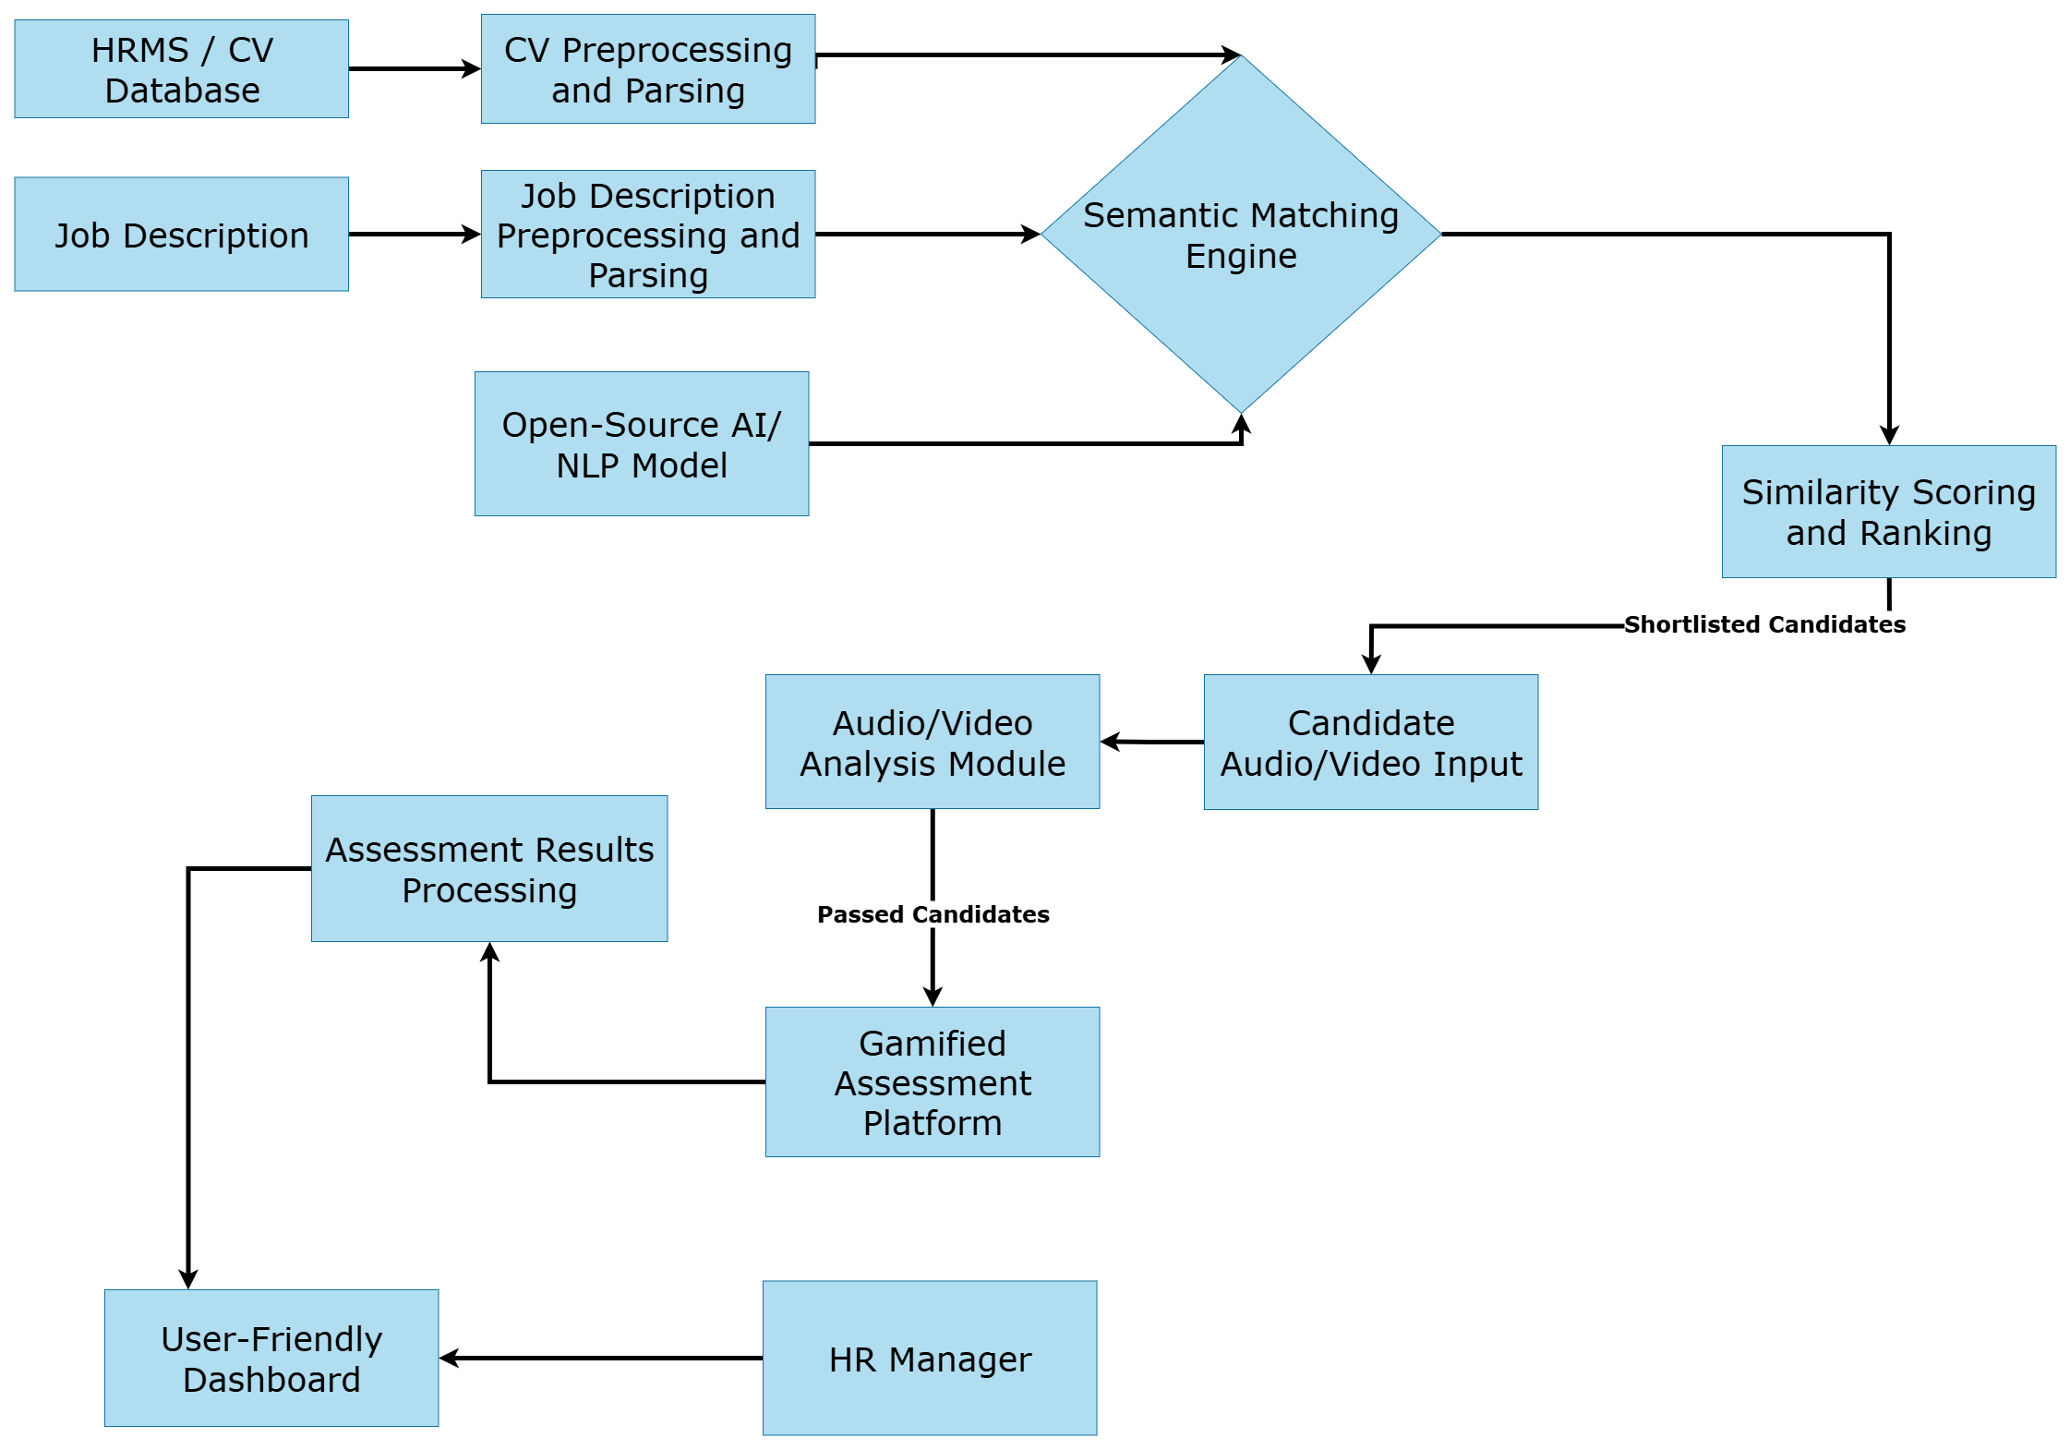
Proposed Design Methodology/Architecture

Slide 11
Hardware/Software Tools
Tools Selection Rationale
Software:
Python 3.12 (core lang—versatile for AI/ML).
NLP: Hugging Face Transformers (BERT/Sentence-BERT—pre-trained, efficient for semantic matching; chosen for open-source accessibility and 90%+ accuracy on benchmarks).
CV: OpenCV/MediaPipe (video analysis—lightweight, real-time facial/speech processing).
Frontend: React.js (dashboard—user-friendly, responsive).
Backend: Flask/Django (API integration—scalable with HRMS).
Hardware: Standard laptop (Intel i7, 16GB RAM, GPU optional for training—cost-effective for prototype; cloud (AWS/GCP) for scaling).
Why These? Open-source to minimize costs; proven in lit for recruitment AI (e.g., BERT in 70% of tools).
Notes:
For software, we’ll use Python as the main language, Hugging Face Transformers for NLP, and OpenCV/MediaPipe for video analysis. The frontend will be in React, backend in Flask or Django, and for deployment, we may use cloud platforms like AWS. All tools are open-source, cost-effective, and widely used in recruitment AI systems. Our hardware setup includes a Core i7 laptop with 16GB RAM, suitable for development and testing.

Slide 12
Proposed Work Plan
Semester-Wise Breakdown (Session 2022-2026; Focus on FYP Phases)
Modules/Tasks: Research & Lit Review; CV Analyzer Dev; Interview Module; Gamified Integration; Dashboard & Testing; Documentation.
Timeline: 6 months total (Oct 2025 - June 2026).
Team Workload: Umair Ahmad (backend/AI),
Zunaira Akbar (frontend/integration).
Notes:
Our project will be completed in six months — from October 2025 to June 2026. First, we’ll do research and literature review, then develop the CV analyzer, followed by the interview and gamified modules, and finally the dashboard and testing phase. Umair will mainly handle backend and AI parts, while I’ll focus on frontend and integration. We’ll collaborate closely on testing and documentation.

Slide 13
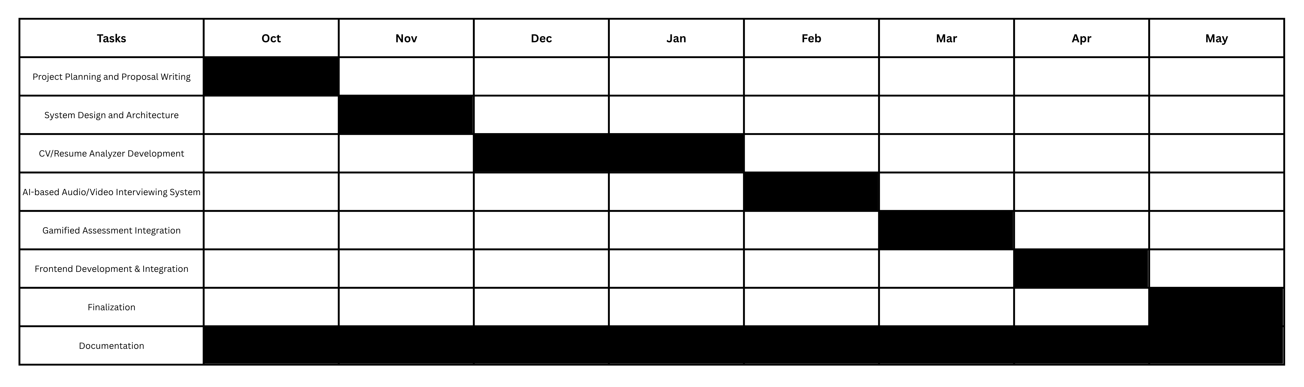
Proposed Work Plan

Slide 14
Thank You
Notes:
That’s all from our side. Thank you for listening patiently. We’ll now be happy to answer any questions.

